Slide 1

Medical Disinformation wit Political Itent

Slide 2
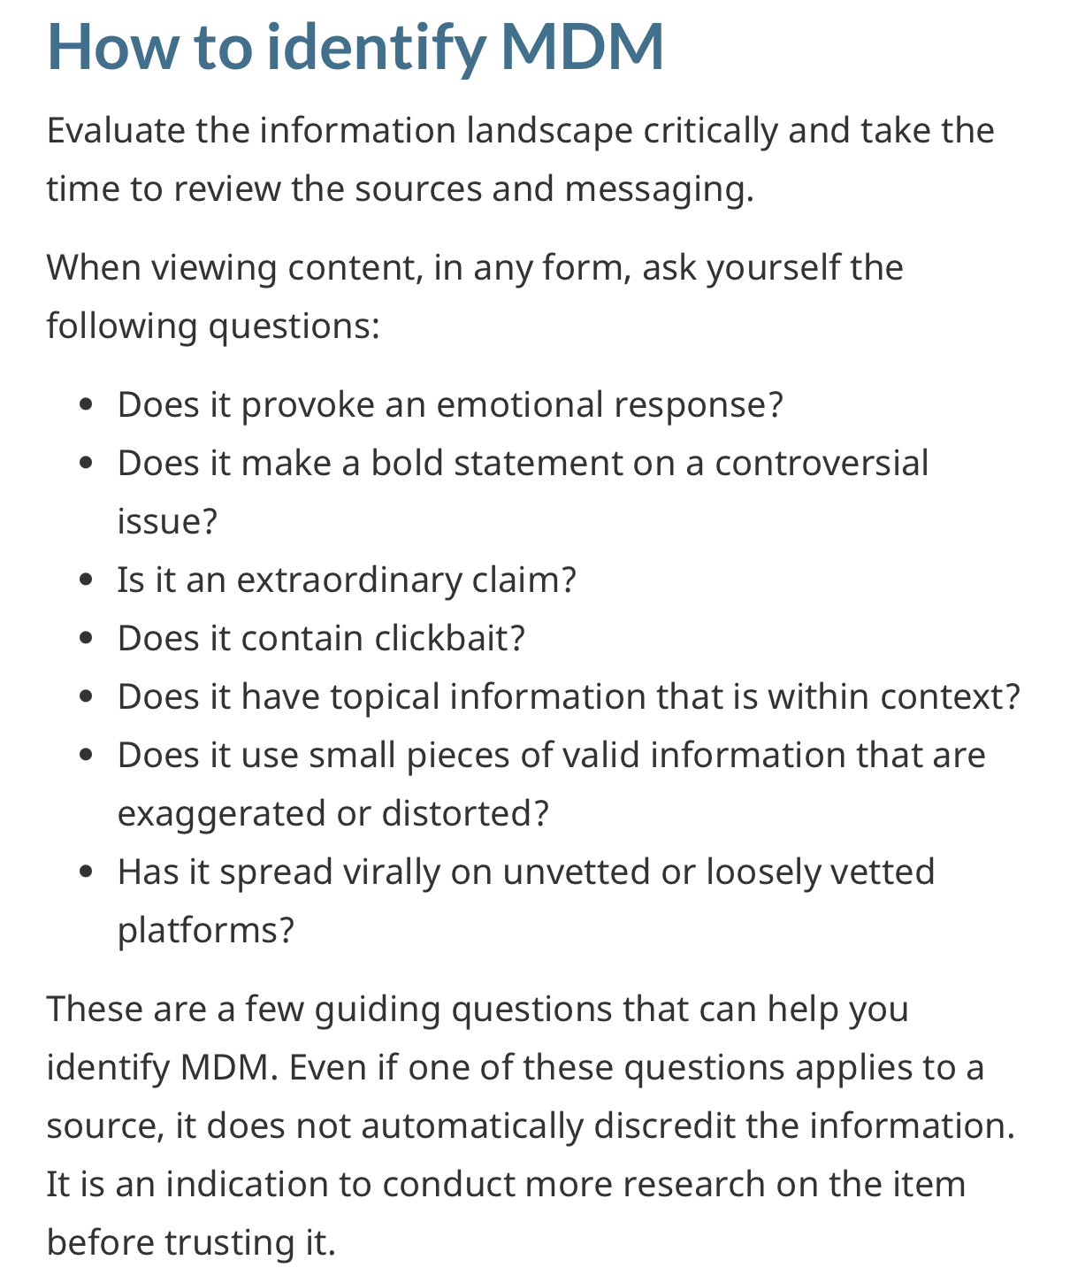
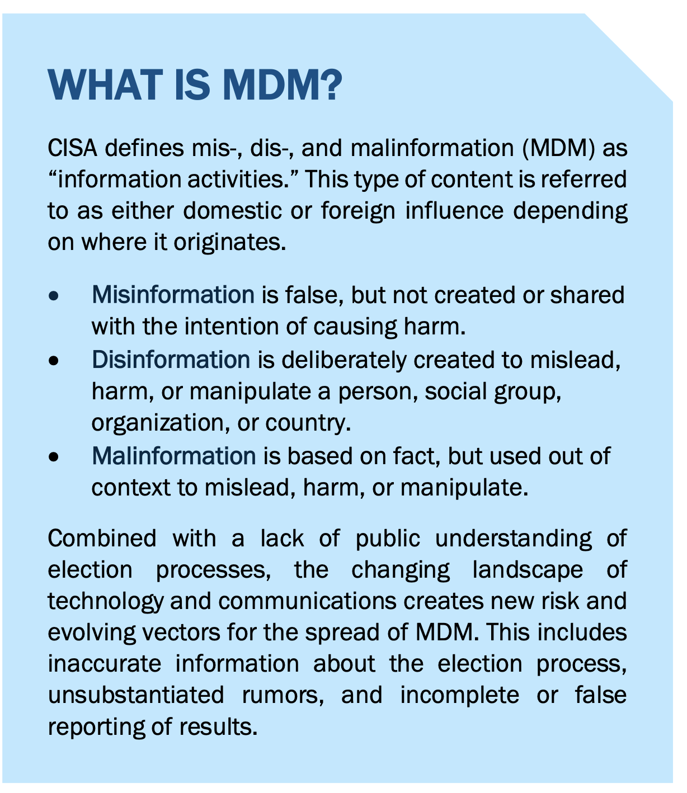
Dis- Mis- Malinformation
Mis-, Dis-, and Malinformation. Planning and Incident Response Guide for Election Officials. https://www.cisa.gov/sites/default/files/publications/mdm-incident-response-guide_508.pdf
How to identify misinformation, disinformation, and malinformation (ITSAP.00.300). https://www.cyber.gc.ca/en/guidance/how-identify-misinformation-disinformation-and-malinformation-itsap00300

Slide 3
Research Questions
Why did Peruvians believe that the Sinopharm vaccine was ineffective?
Where and when did the hoax start?
How did it spread?
How long can the effect of disinformation last?
What factors contribute to the penetration and persistence of a hoax over time?
Can debunking counteract a hoax? If not, why?

Slide 4
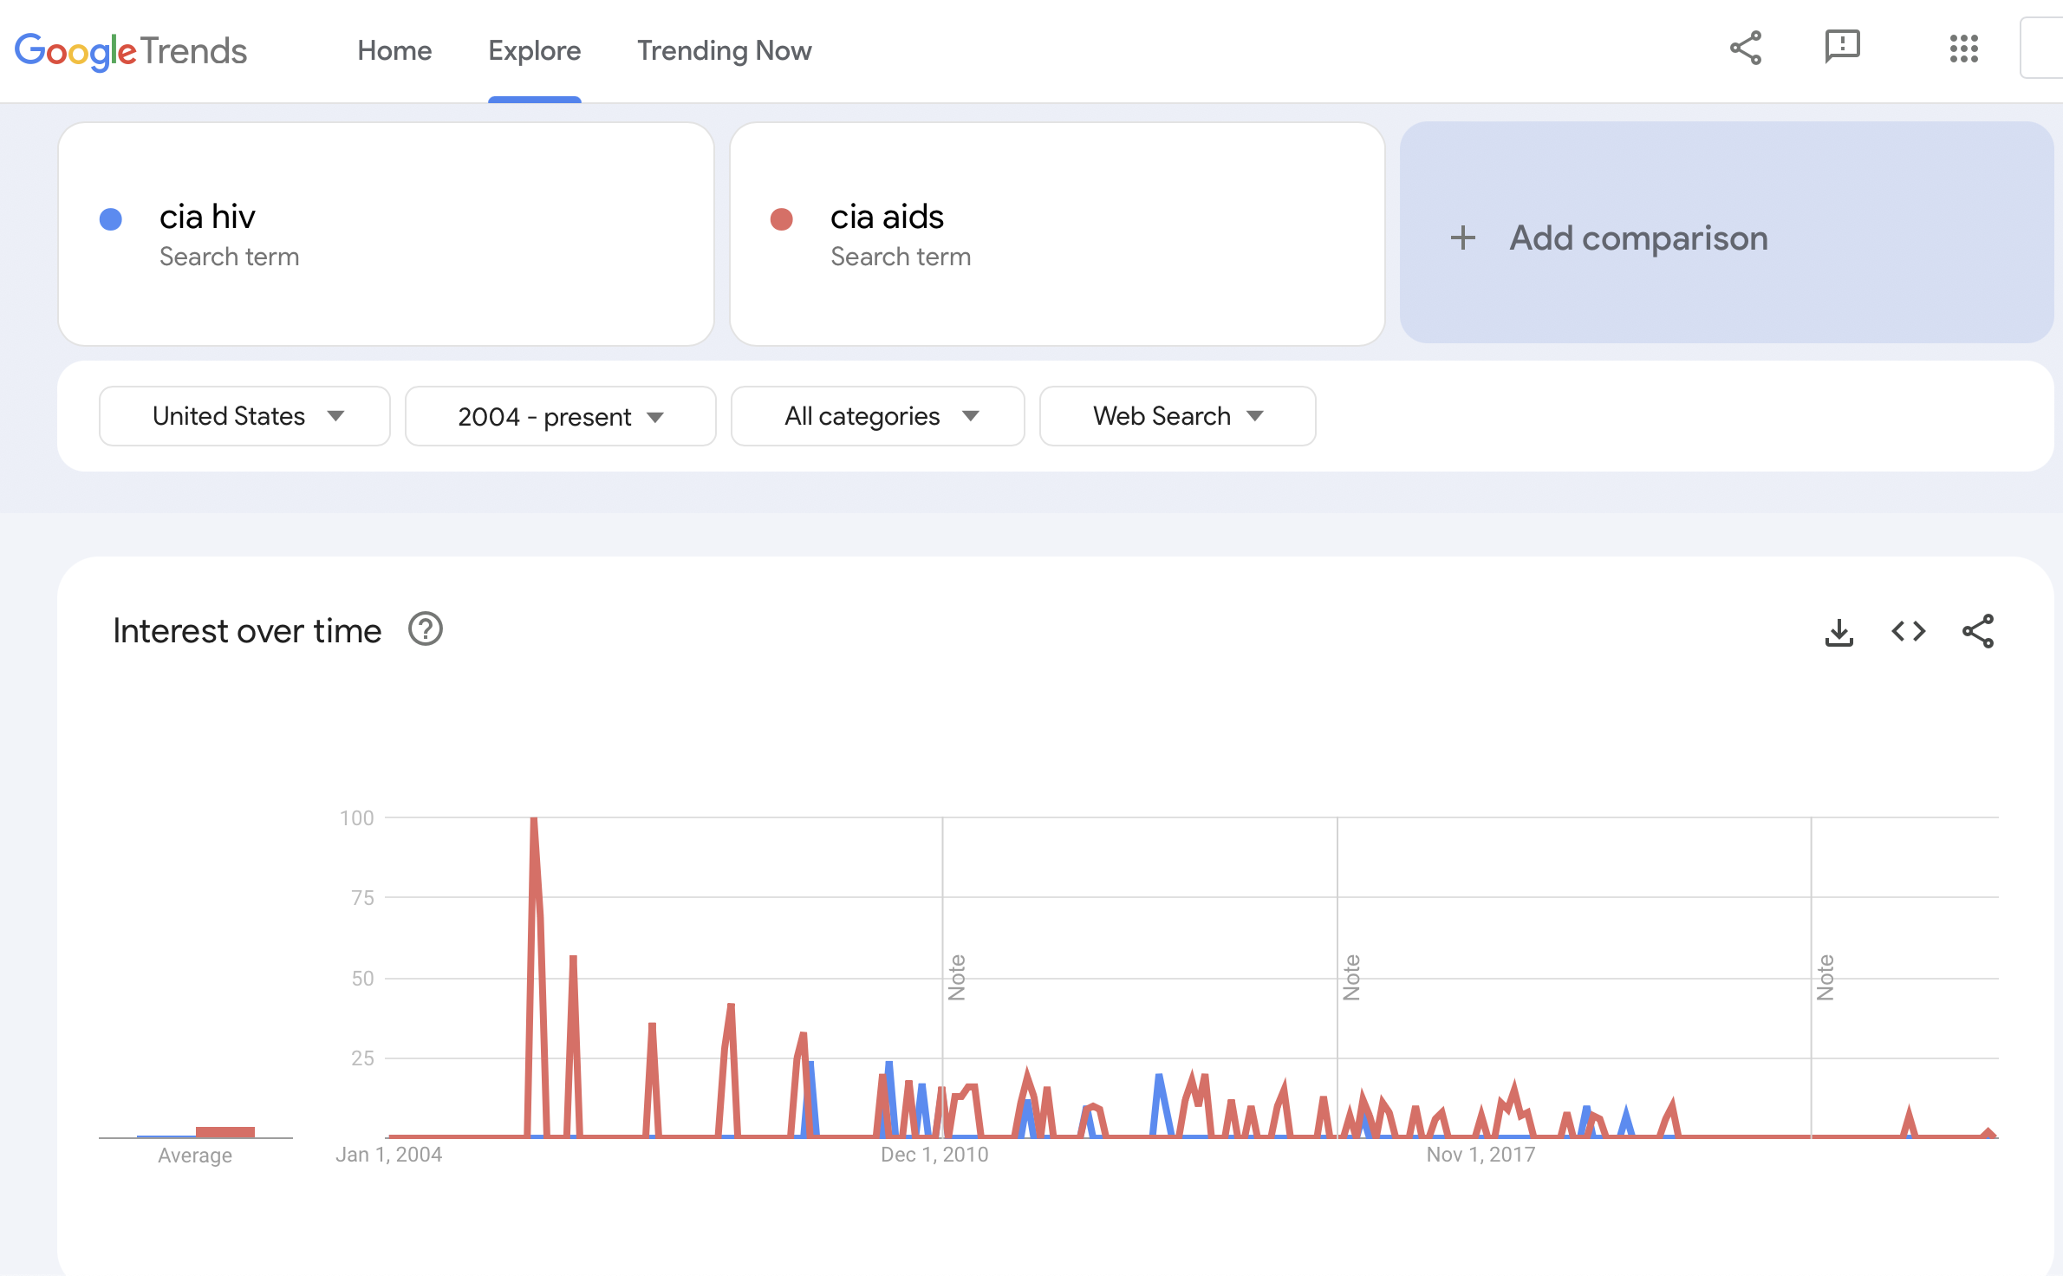
The persistence of a conspiracy theory

Slide 5
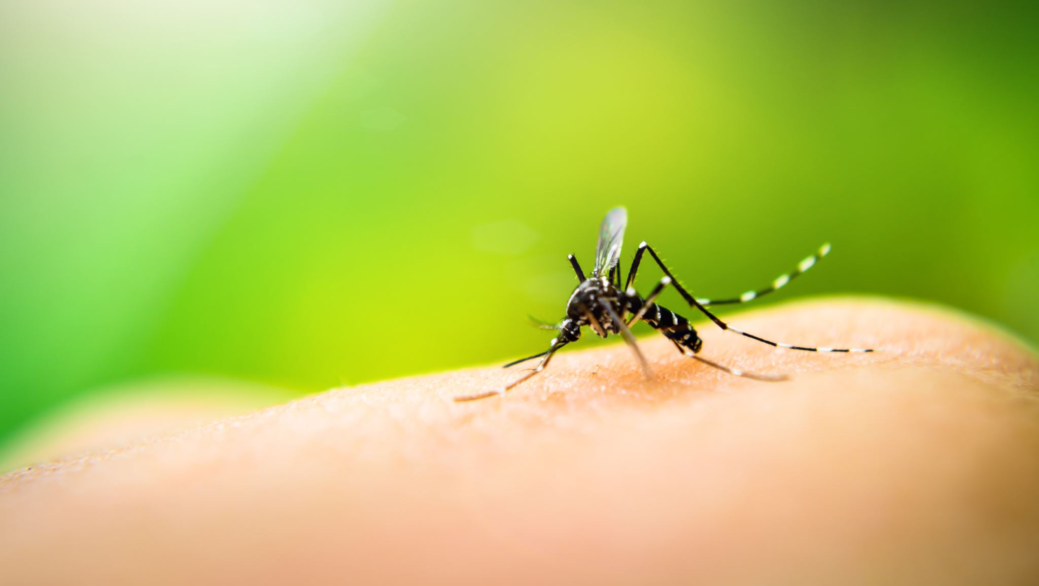
The Spreaders (vectors)

Slide 6
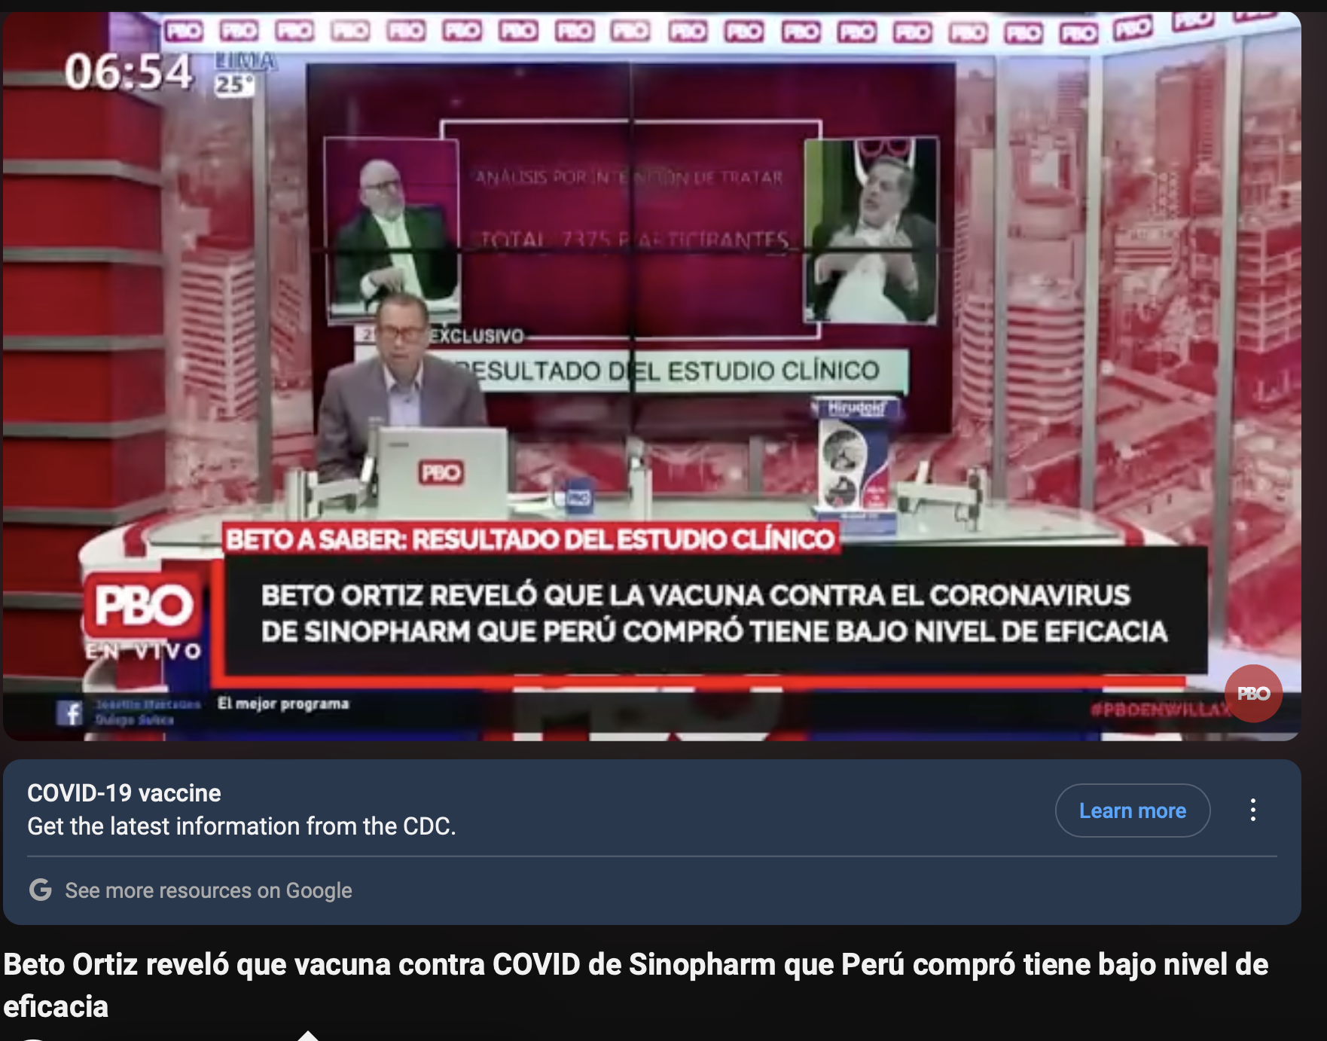
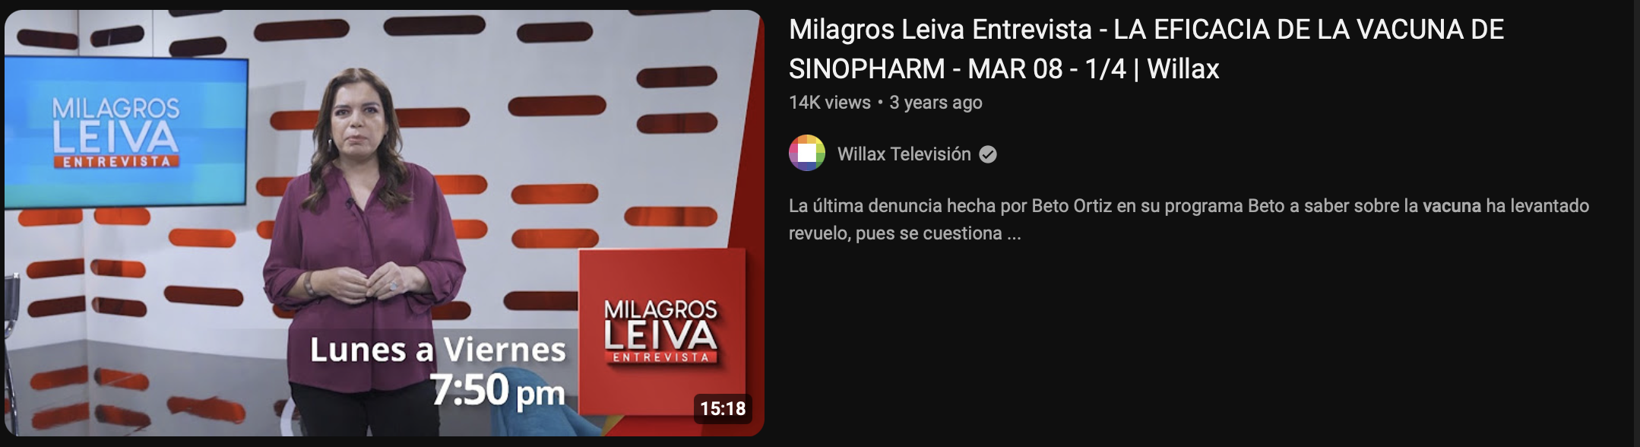
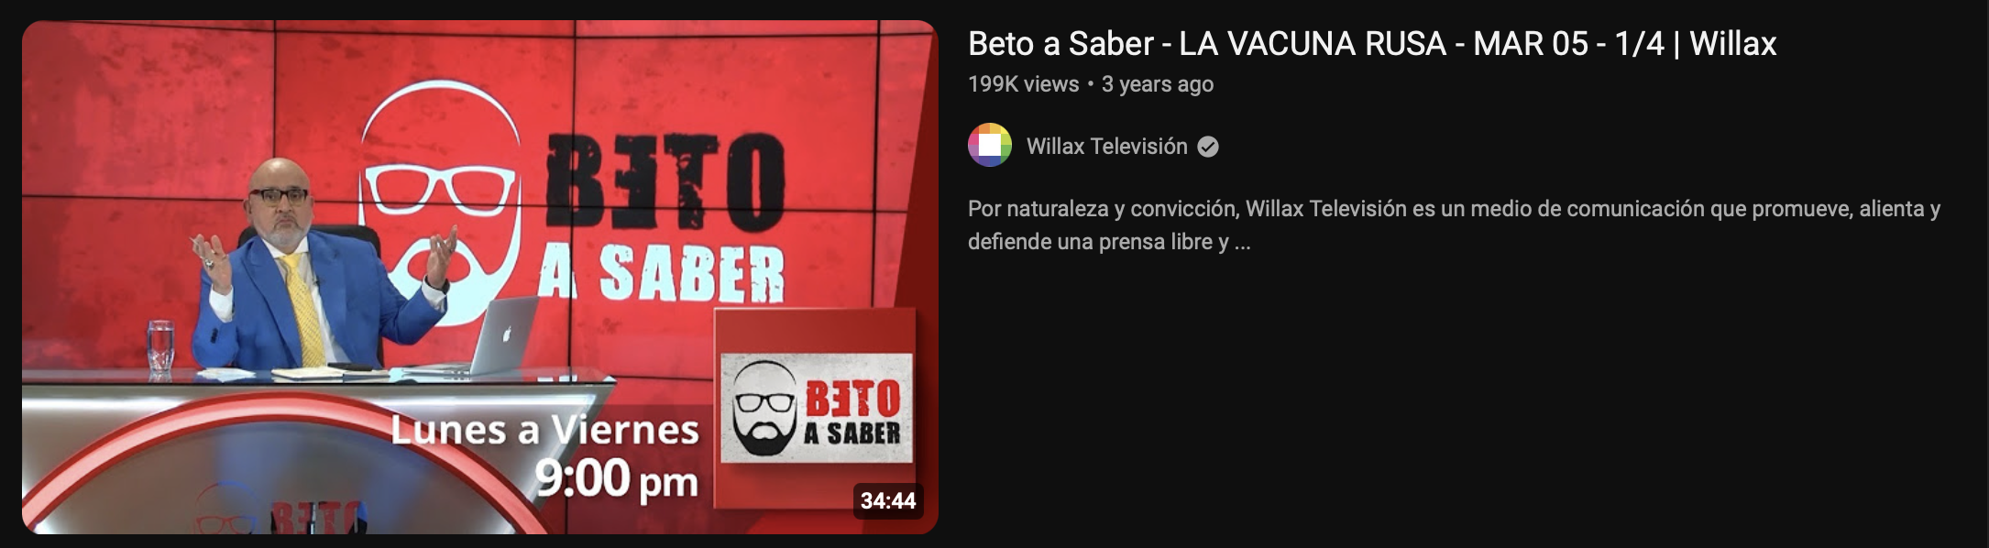
The Players

Slide 7
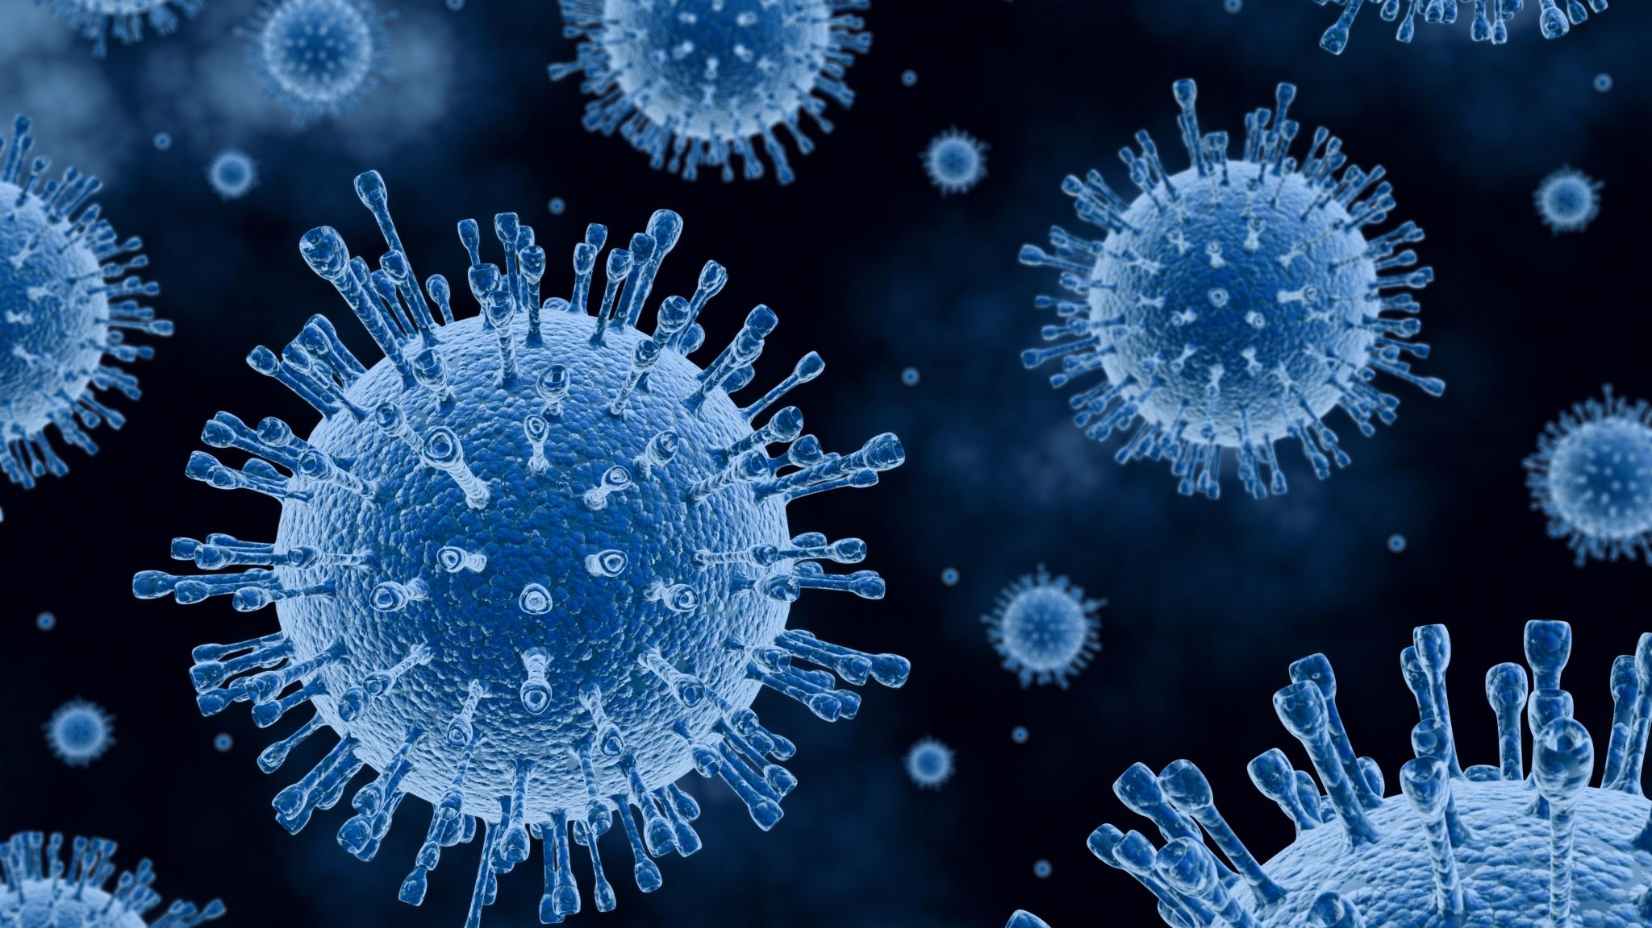
The virus

Slide 8
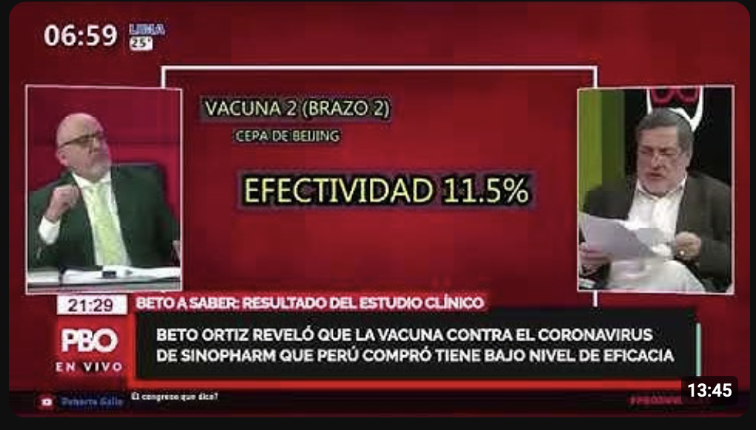
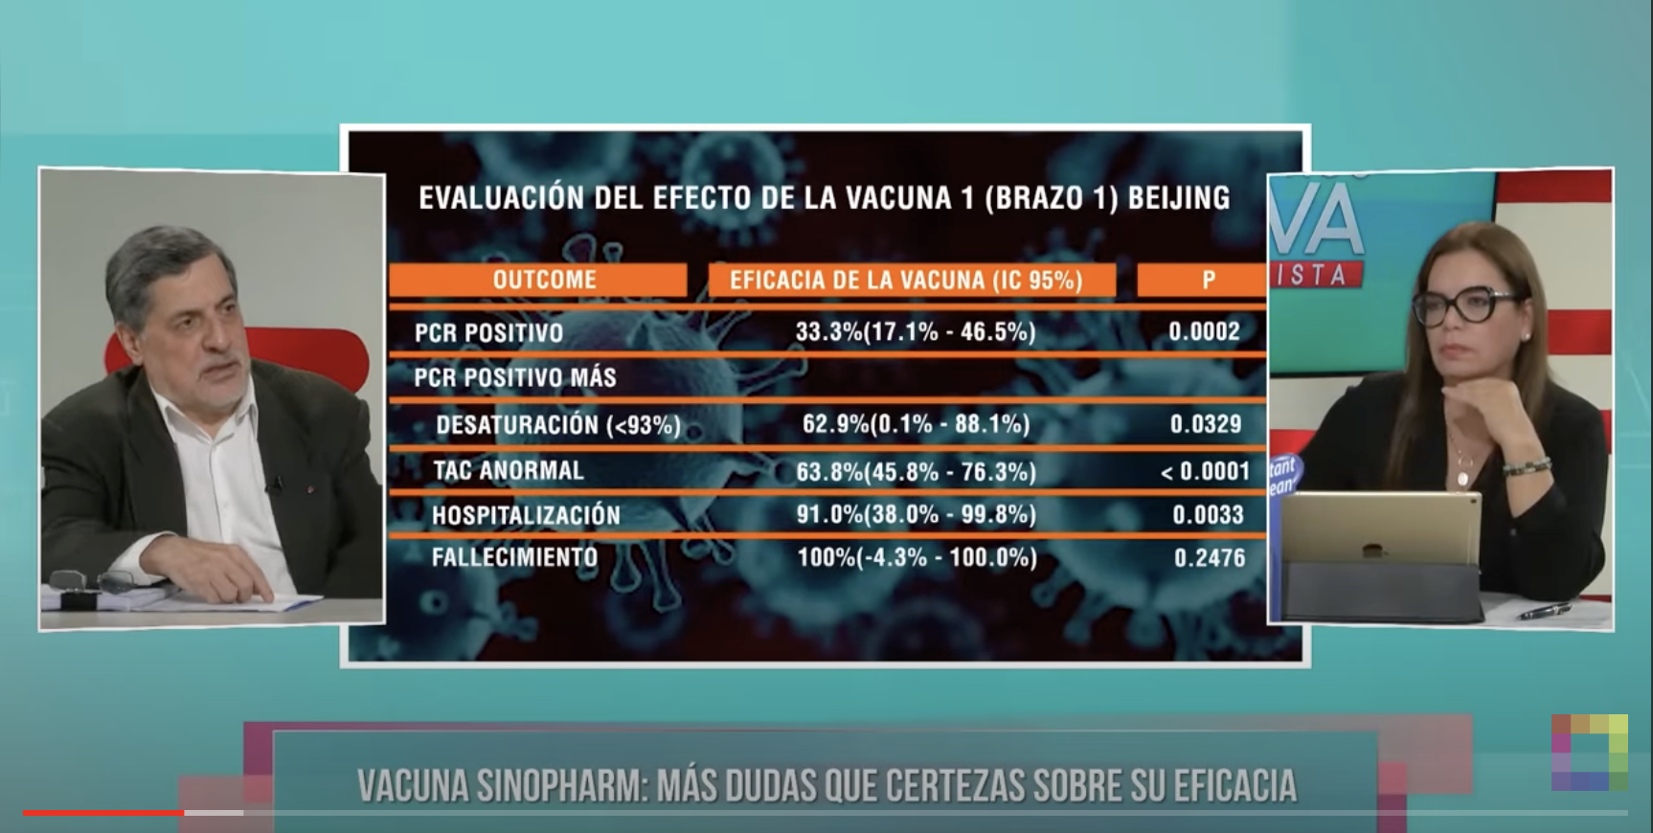
March 5, 2021. The Beto a Saber Interview

Slide 9
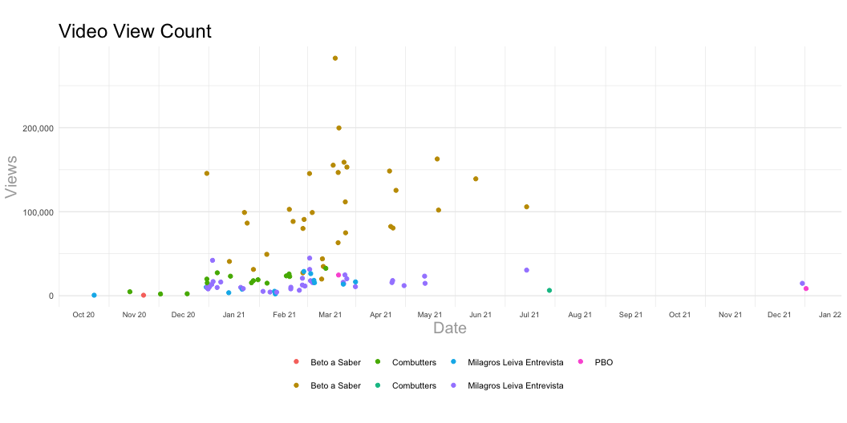

Slide 10
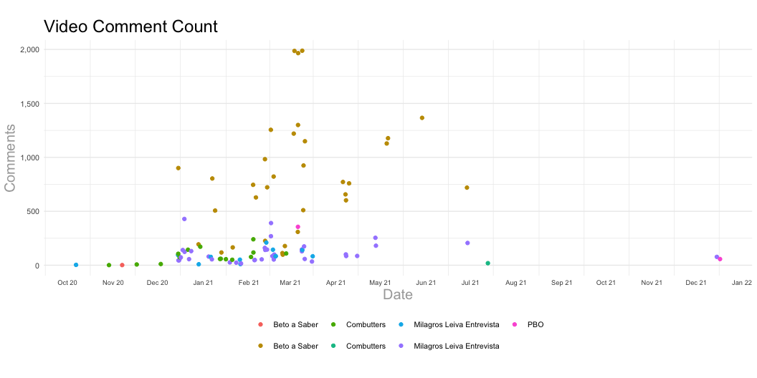

Slide 11
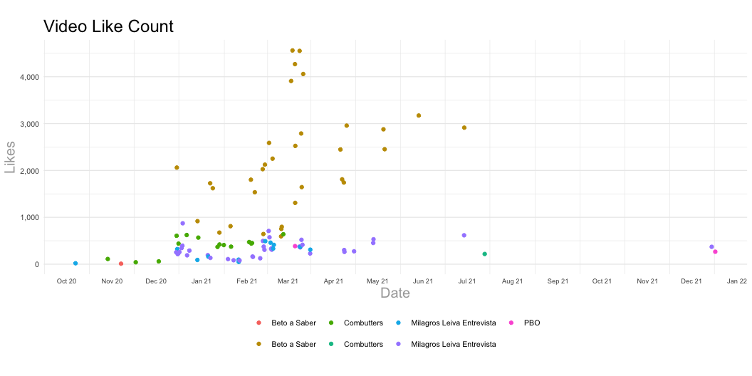

Slide 12
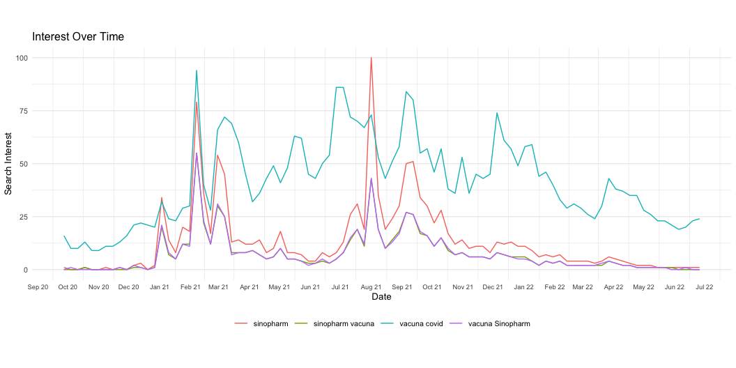

Slide 13
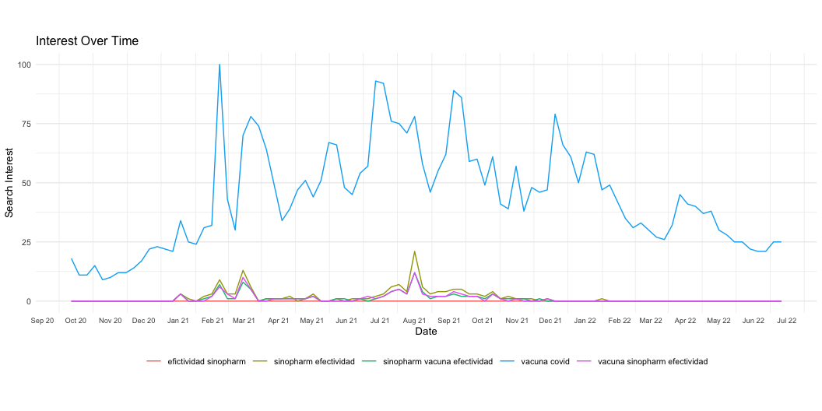

Slide 14
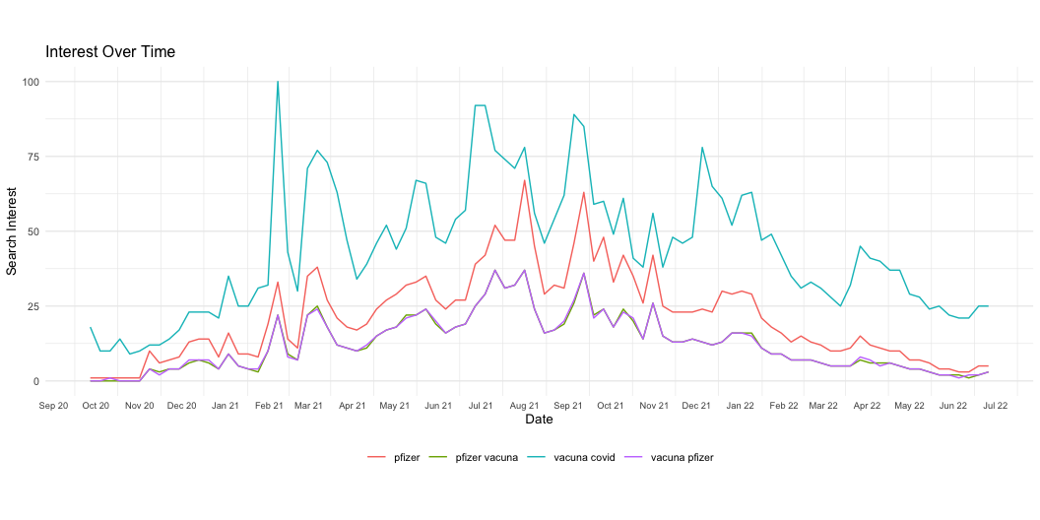

Slide 15
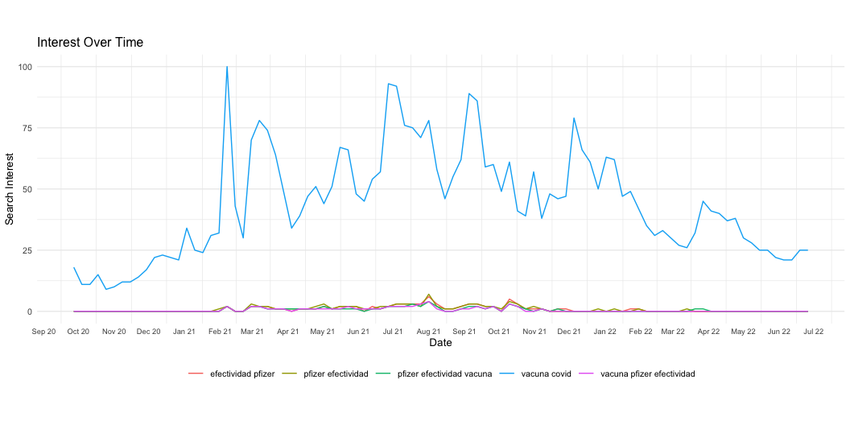

Slide 16
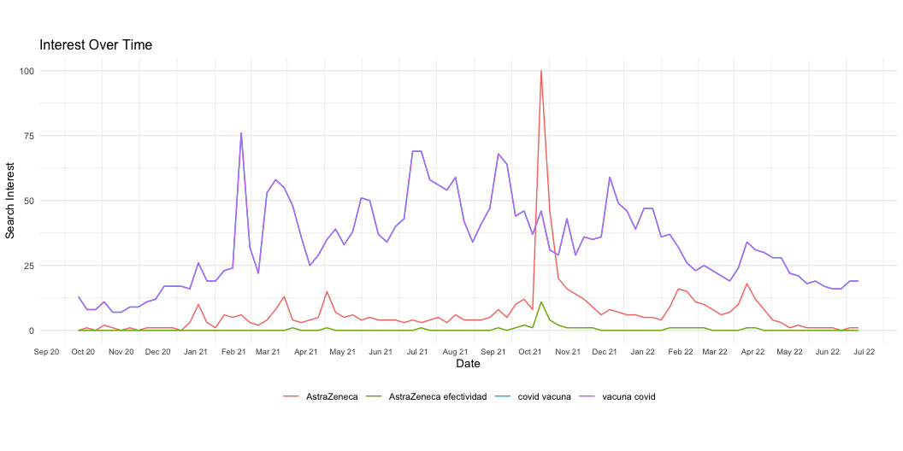

Slide 17
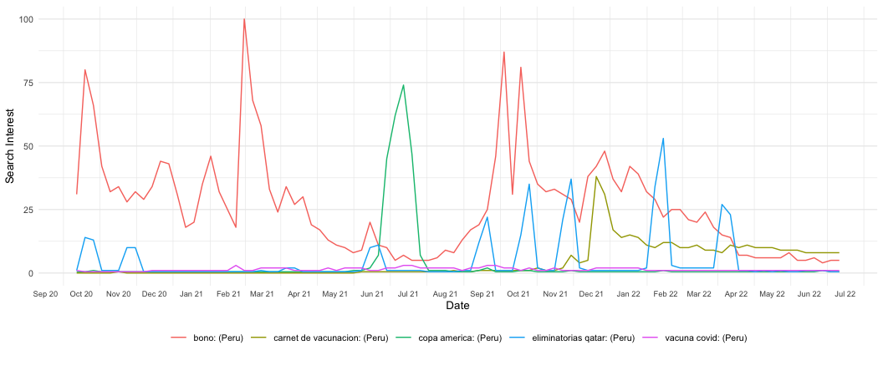
The numbers in perspective

Slide 18
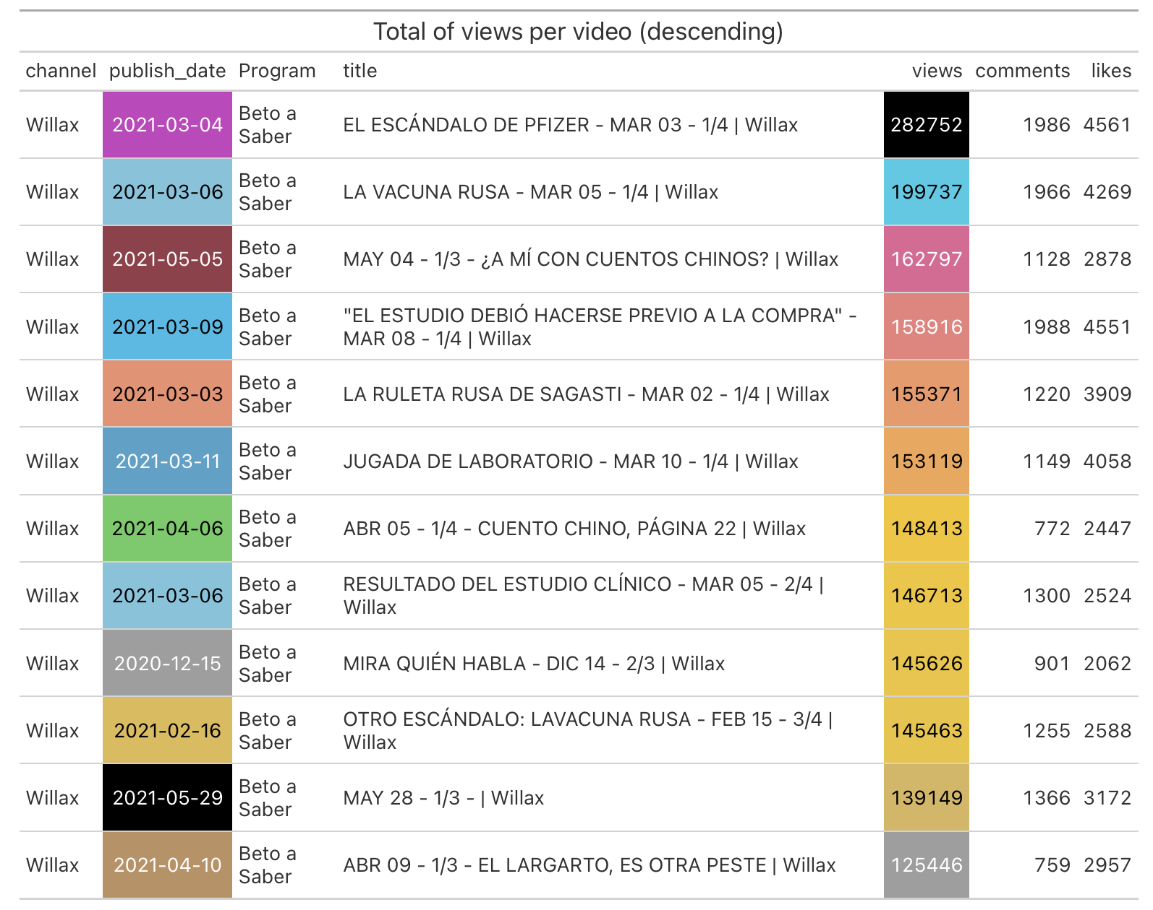
Sample Study
Extreme Dates
October 1, 2020 – December 31, 2021
Keyword filter
'Sinopharm', 'Sinovac', 'vacuna china', 'eficacia', 'vacuna', 'bustamante’
Sampled Videos
101

Slide 19
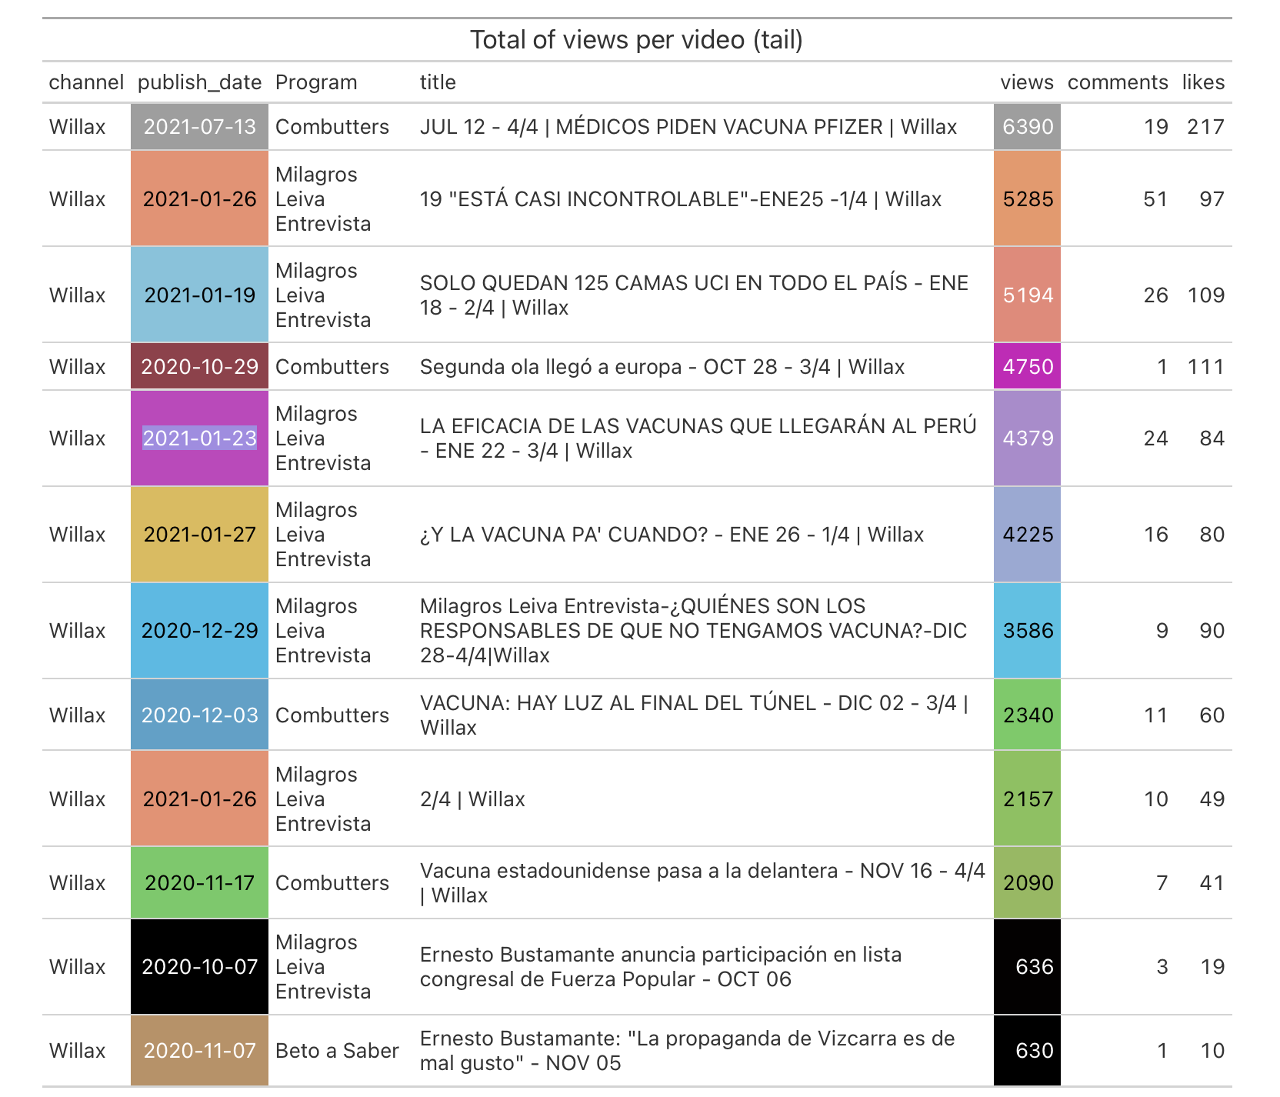

Slide 20
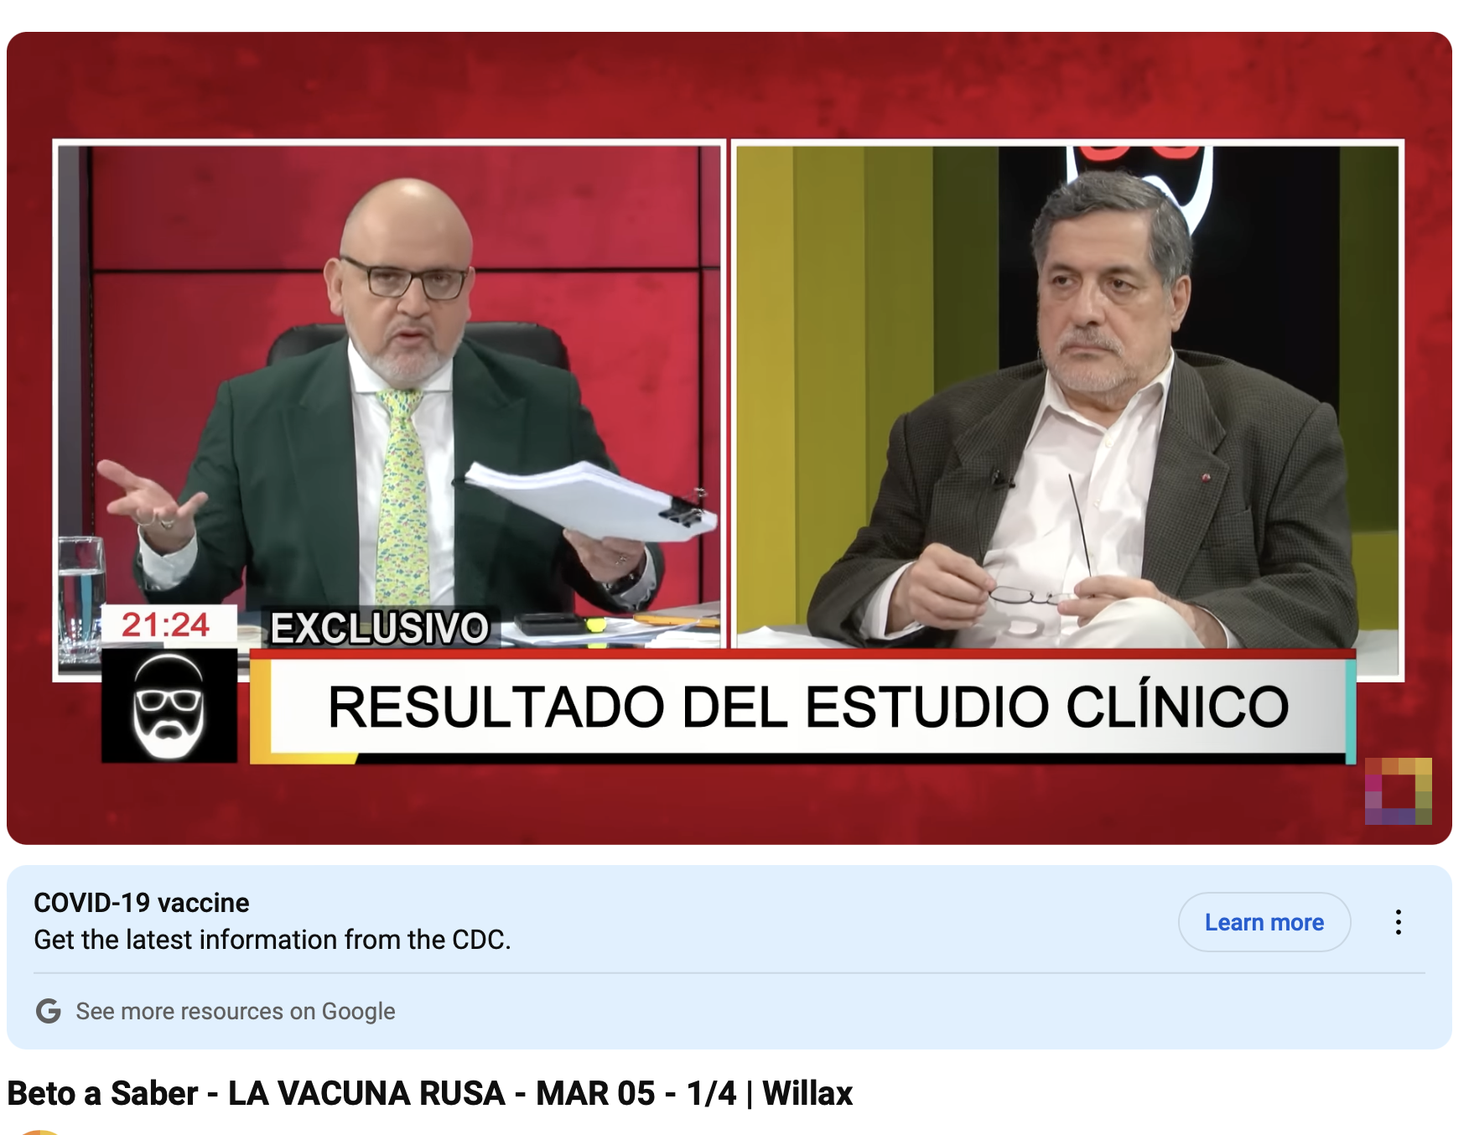
Case Study: The Virus, i.e. the March 5, 2021 interview
"video_id": "9K9Vpk2N38M",
"channel_title": "Willax Televisi\u00f3n",
"video_title": "Beto a Saber - LA VACUNA RUSA - MAR 05 - 1/4 | Willax",
"video_view_count": "199737",
"video_comment_count": "1966",
"video_like_count": "4269",
"video_dislike_count": null,
"video_tags": "willax|willaxtv|televisi\u00f3n|tv|television|peru|per\u00fa|vivo|canal|movistar|claro|best|cable|bestcable|hd|digital|video"

Slide 21
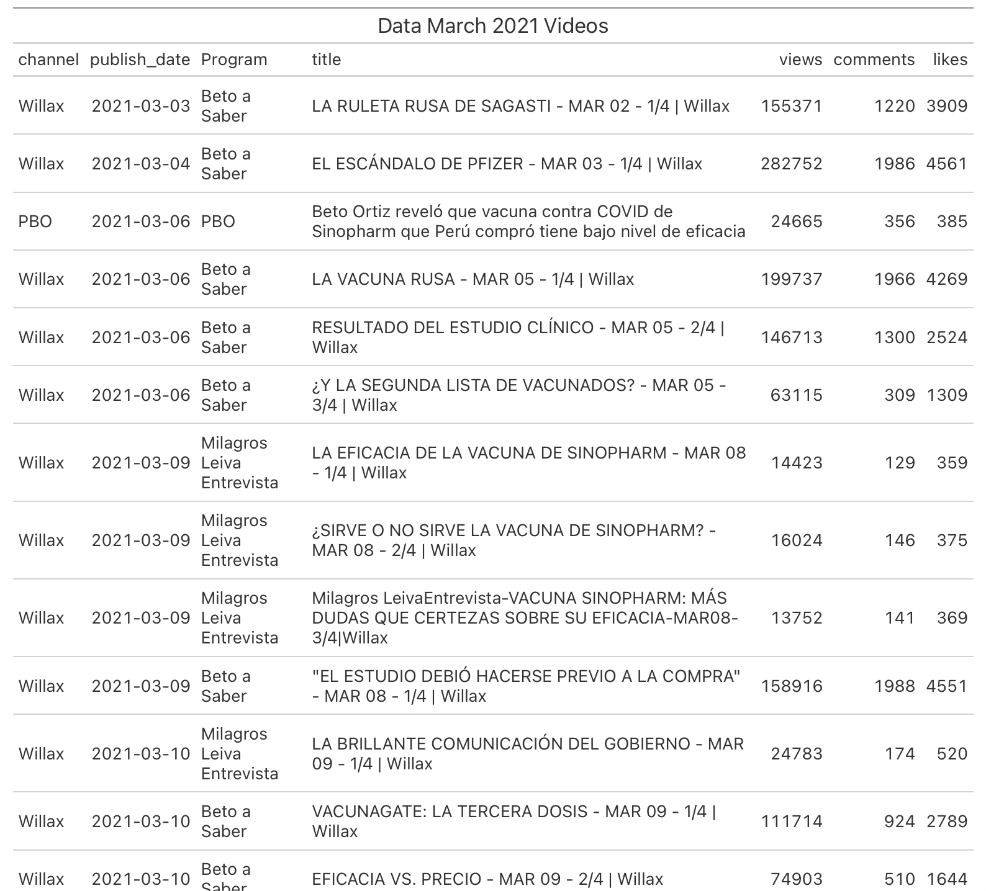

Slide 22
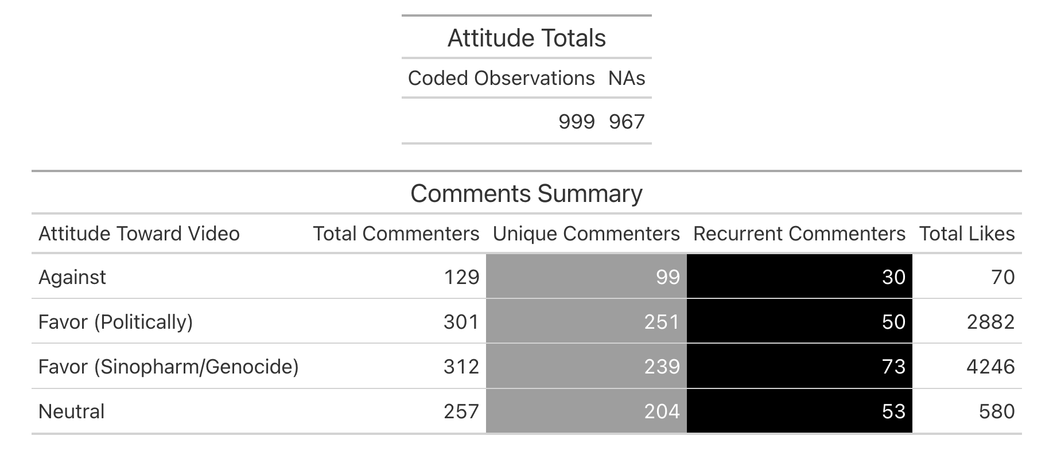
Comments Summary

Slide 23
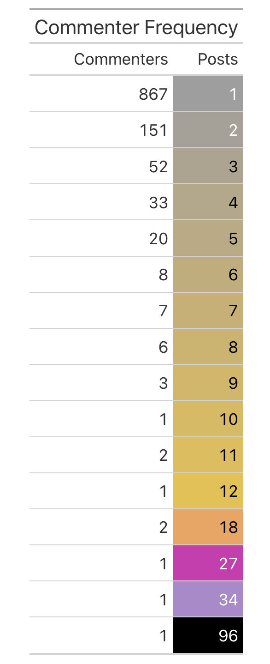
Unique and recurrent commenters by the number of posts in one video

Slide 24
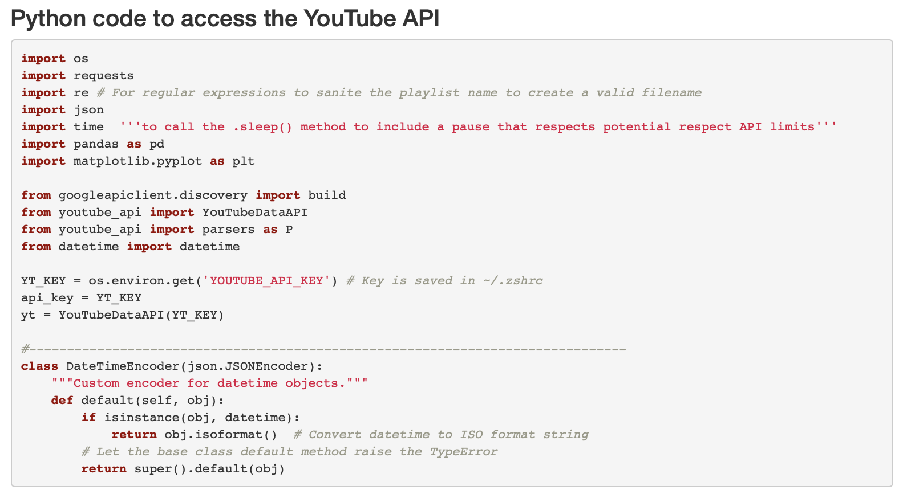
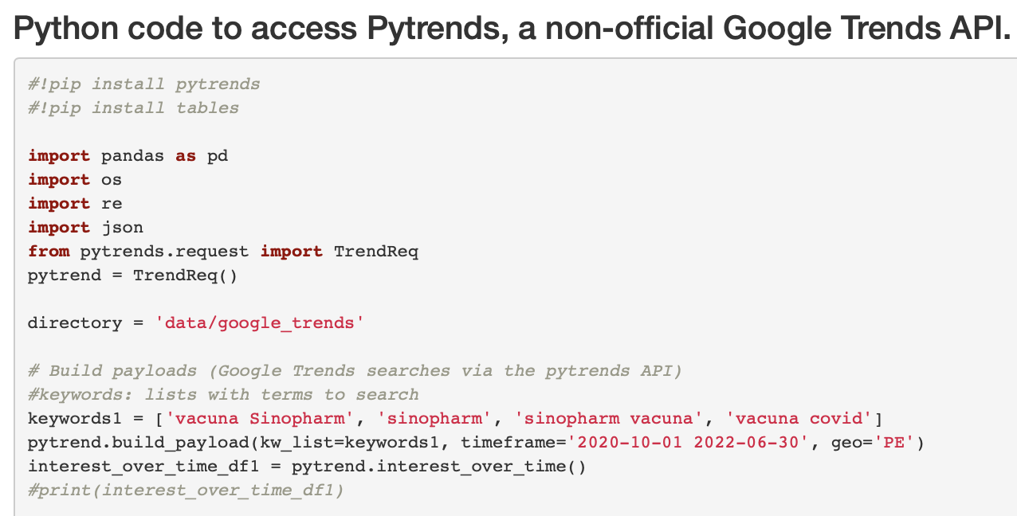
Python: Packages and APIs

Slide 25
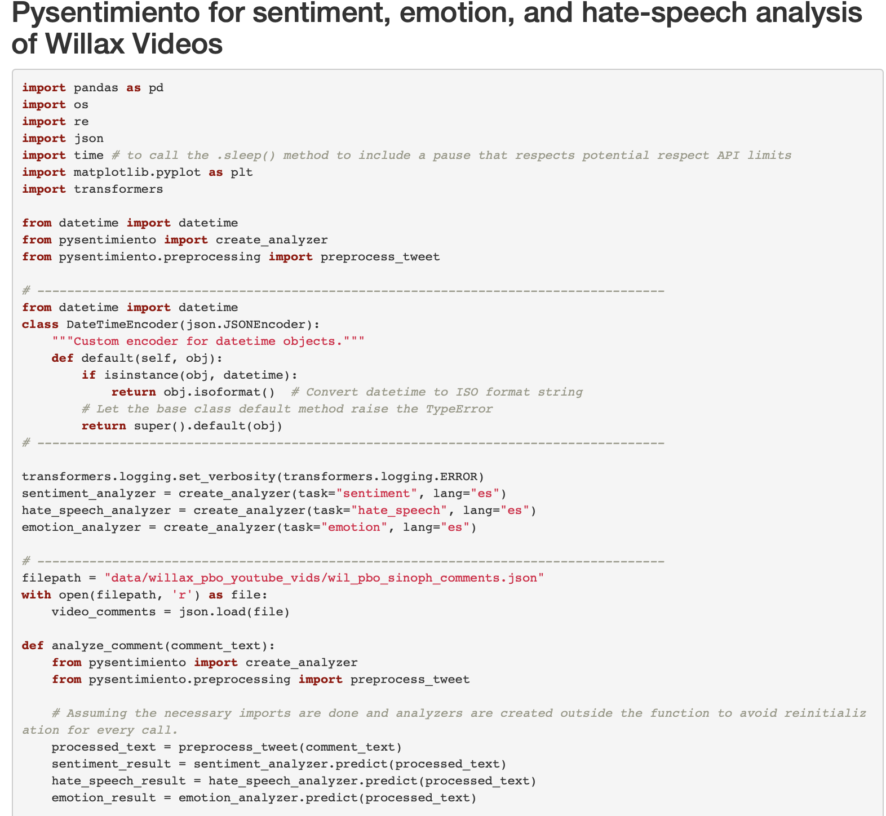

Slide 26
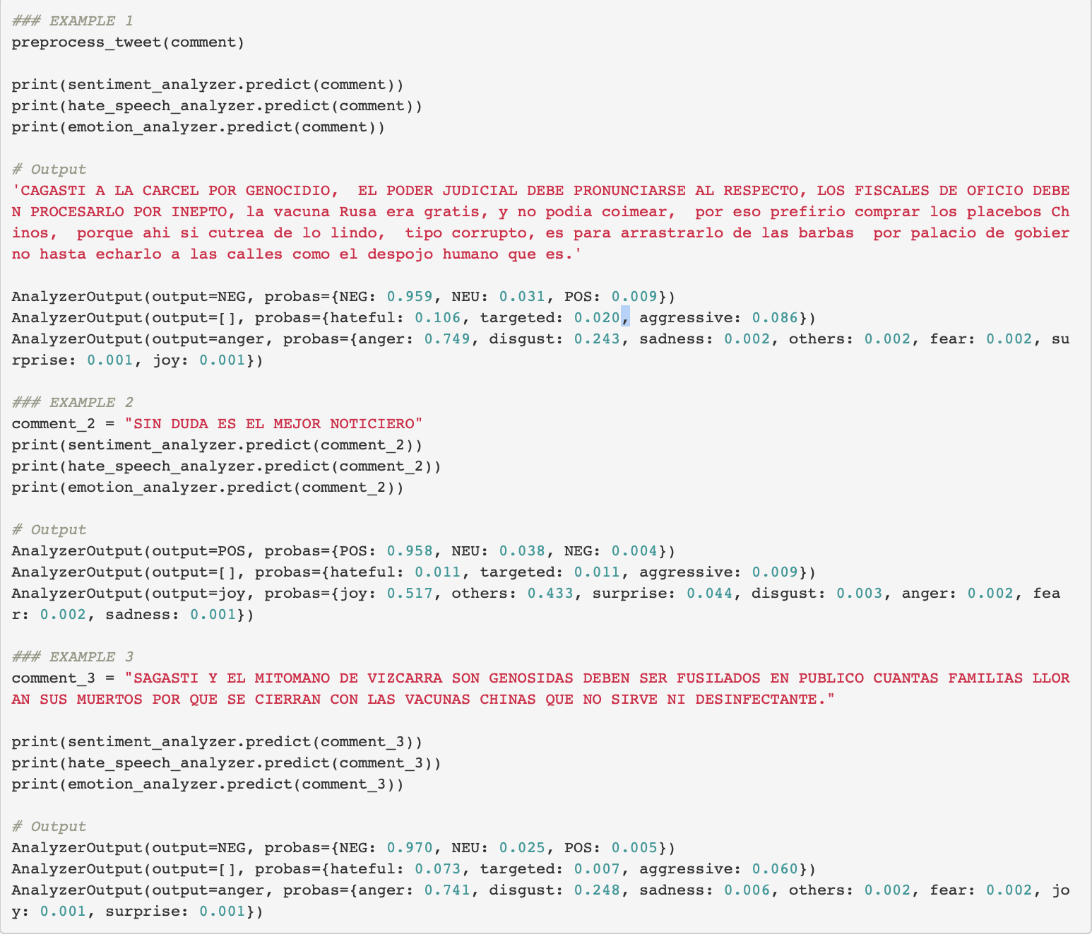
Pysentimiento analysis

Slide 27
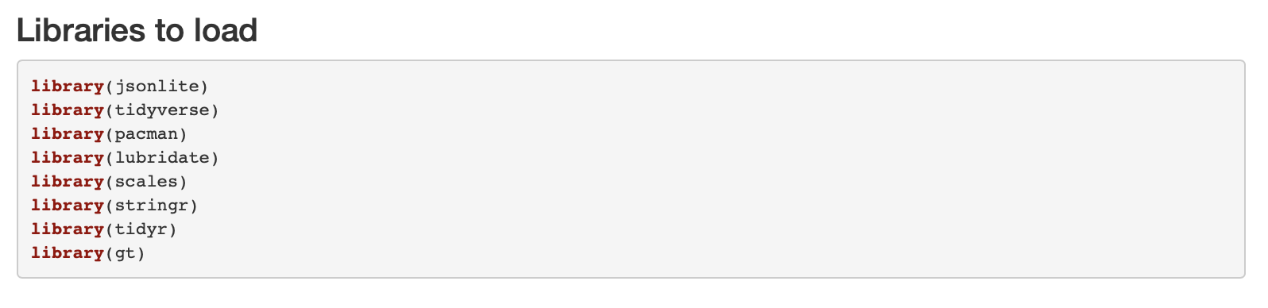
R packages

Slide 28

Next Steps for Disinformation
Train a prediction model (possibly RoBERTA or RoBERTuito) for text classification to predict the comment’s attitudes based on a hand-coded set.
Create a network (indirect?) of commenters using the commenters’ channels or screen names as nodes and the videos and channels in which they comment as links.
How can I factor number of comments made, likes, and replies?
Repeat the method and steps followed for Willax with other channels and media to find the penetration and prevalence of disinformation
Carry out sentiment and emotion analysis on the comments.
Create a Wordcloud
Compare the views, number of comments, and commenter attitudes between the disinformation and debunking videos to see what type of information and data have more taction

Slide 29

Next Steps for Bustamante
Count how many appearances had Bustamante since 2020 on the two channels, Willax and PBO
Count how often he appeared since he launched his congressional campaign
Count the views those appearances had
Count Bustamante’s appearances since his appearance on March 5, 2021, the number of video views, and endorsing comments until the April 11 elections.
Do a similar check in other channels to see how his media presence changed since the Beto a Saber 3/5/2021 interview.
Compare the numbers to to build up on the argument that this interview propelled his candidacy for Congress

